Slide 1

Project Title: Crownfield Eye Hospital Ophthalmology Database System
Module Title: Introduction to Database
Presenter: Fabio Andrade
Project Objective: Design, implement, and populate a secure, scalable relational database prototype to replace legacy paper records, Word documents, and Excel spreadsheets at Crownfield Eye Hospital.
Individual Contribution Statement: Collaborative database design and implementation, with independent ownership of normalisation working, SQL retrieval queries, programmable features, and security controls.

Slide 2
Data Analysis & Problem Definition (Task A1)
Legacy Data Source: Examined Crownfield Eye Hospital’s unnormalised dataset , storing all operations in a single flat file.
Errors Found: Non-atomic values, repeating groups (e.g., multiple medicines Latanoprost | Timolol in one cell), and incomplete records.
Data Redundancy: Static attributes like patient names (Amina Yusuf), clinician names (Dr Maya Shah), and clinic locations (City Road) are duplicated across rows.
Anomalies Identified:
  Insertion: Cannot add a new clinician without creating an appointment.
  Deletion: Removing Daniel Reed’s appointment erases the only record of Dr Leo Grant.
  Update: Changing Dr Maya Shah’s details requires updating multiple rows, risking inconsistencies.

Slide 3
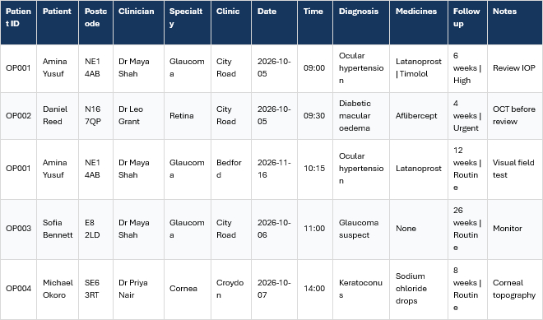
Data Analysis & Problem Definition (Task A1)

Slide 4
Conceptual Data Model & ERD (Task A2)
Core Entities: Established 6 primary tables — Patient, Clinician, Appointment, Diagnosis, Prescription, and Follow_Up_Plan.
Mandatory Relationships (1:M): Patient, Clinician, and Clinic link directly to Appointment using Crow's Foot notation.
Clinical Optionality (1:0..M): Appointments generate zero or more Diagnoses and Prescriptions (e.g., unmedicated visits).
Modelling Justification: Optional relationships accommodate consultations where a diagnosis is recorded without prescribed medication (e.g., Sofia Bennett).

Slide 5
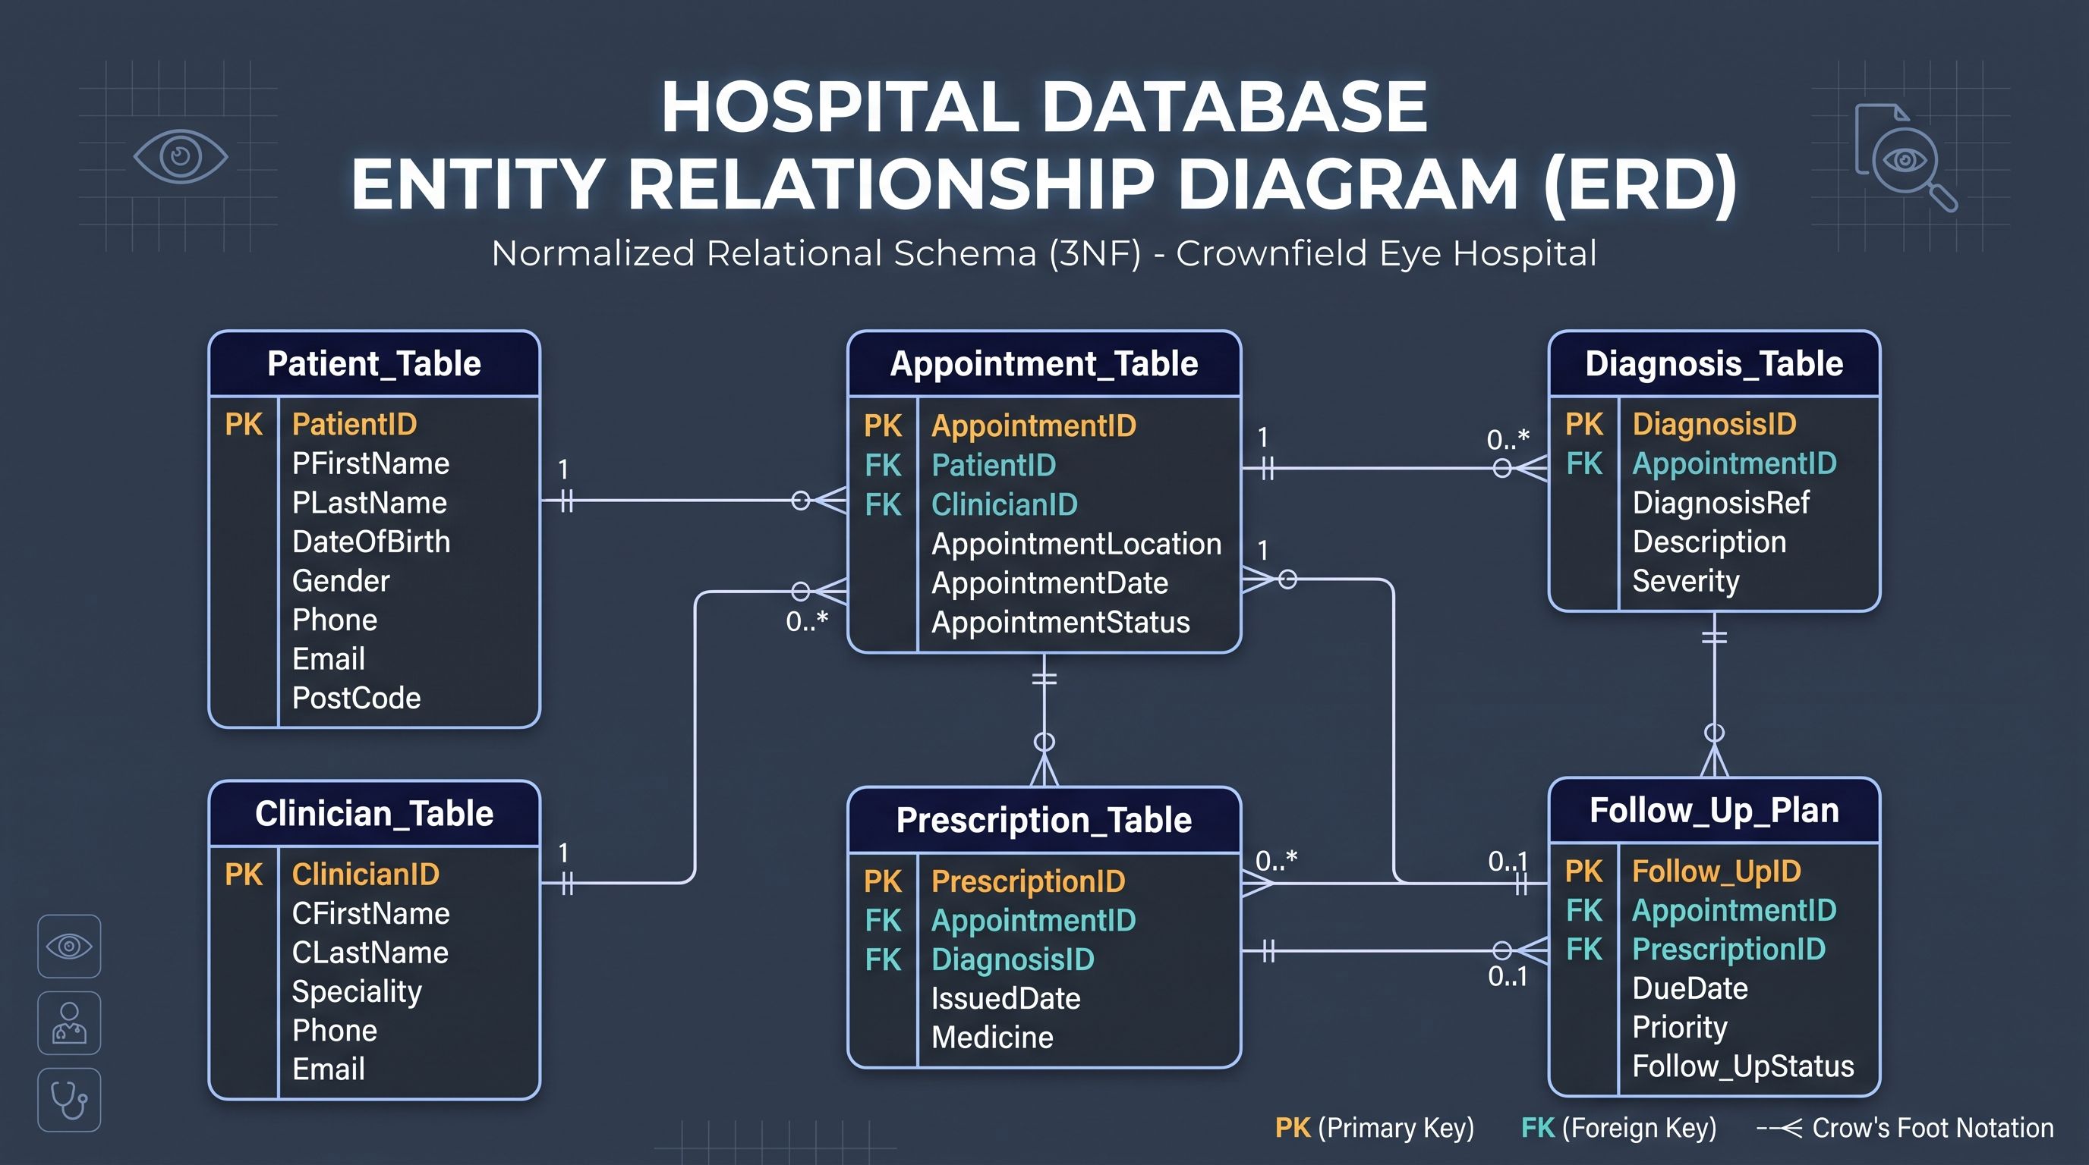

Slide 6
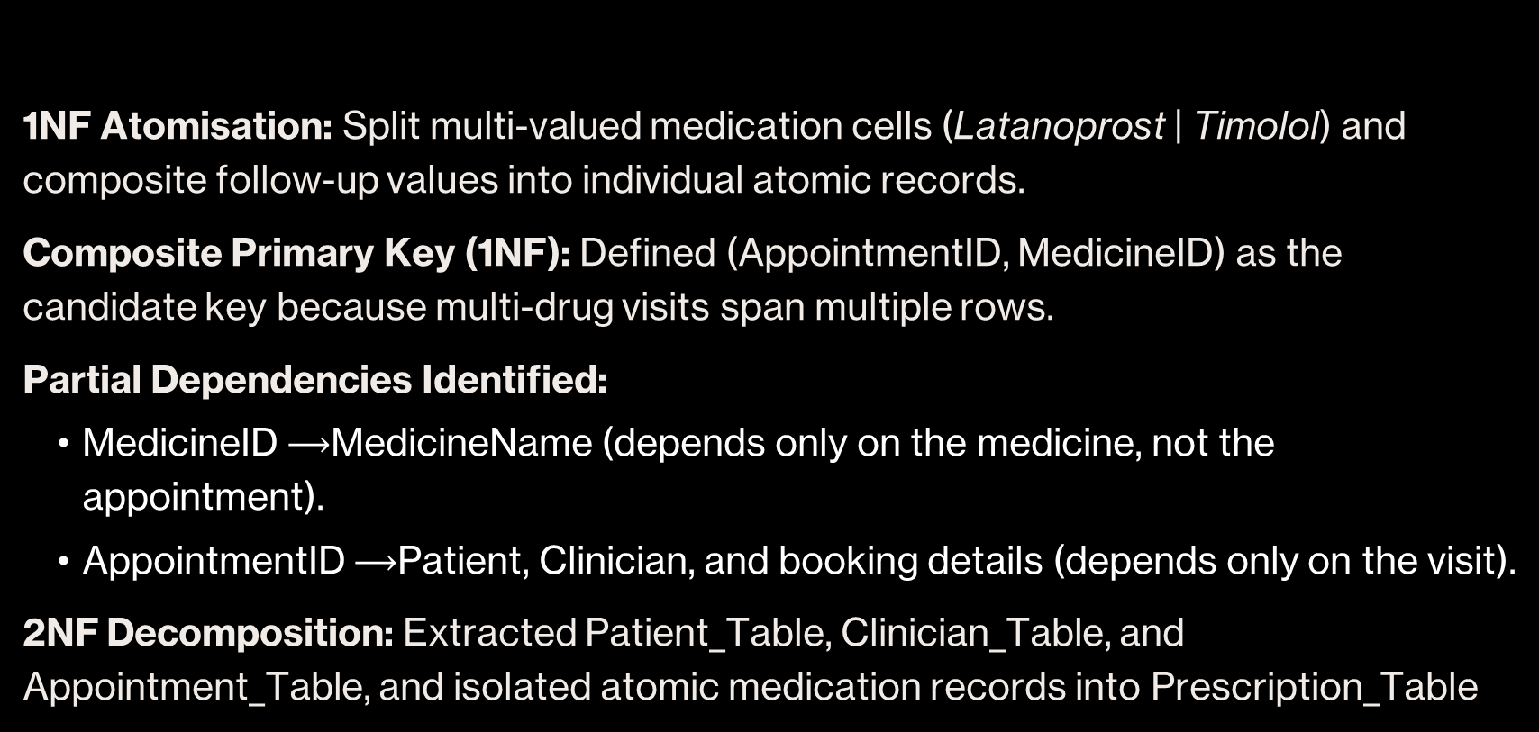
Key Normalisation Decision — UNF to 2NF (Task A3)
1NF Atomisation: Split multi-valued medication cells (Latanoprost | Timolol) and composite follow-up values into individual atomic records.
Composite Primary Key (1NF): Defined (AppointmentID, MedicineID) as the candidate key because multi-drug visits span multiple rows.
Partial Dependencies Identified:
  MedicineID $⟶$MedicineName (depends only on the medicine, not the appointment).
  AppointmentID $⟶$Patient, Clinician, and booking details (depends only on the visit).
2NF Decomposition: Extracted Patient_Table, Clinician_Table, and Appointment_Table, and isolated atomic medication records into Prescription_Table

Slide 7
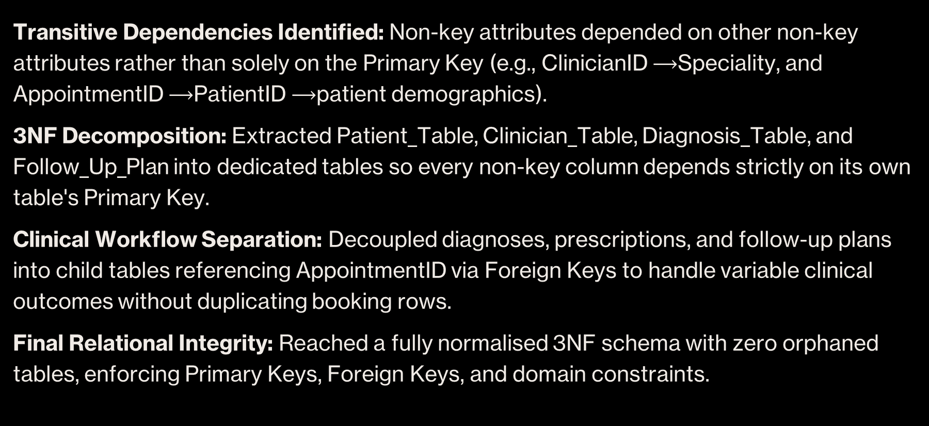
Third Normal Form (3NF) & Final Schema (Task A3)
Transitive Dependencies Identified: Non-key attributes depended on other non-key attributes rather than solely on the Primary Key (e.g., ClinicianID $⟶$Speciality, and AppointmentID $⟶$PatientID $⟶$patient demographics).
3NF Decomposition: Extracted Patient_Table, Clinician_Table, Diagnosis_Table, and Follow_Up_Plan into dedicated tables so every non-key column depends strictly on its own table's Primary Key.
Clinical Workflow Separation: Decoupled diagnoses, prescriptions, and follow-up plans into child tables referencing AppointmentID via Foreign Keys to handle variable clinical outcomes without duplicating booking rows.
Final Relational Integrity: Reached a fully normalised 3NF schema with zero orphaned tables, enforcing Primary Keys, Foreign Keys, and domain constraints.

Slide 8
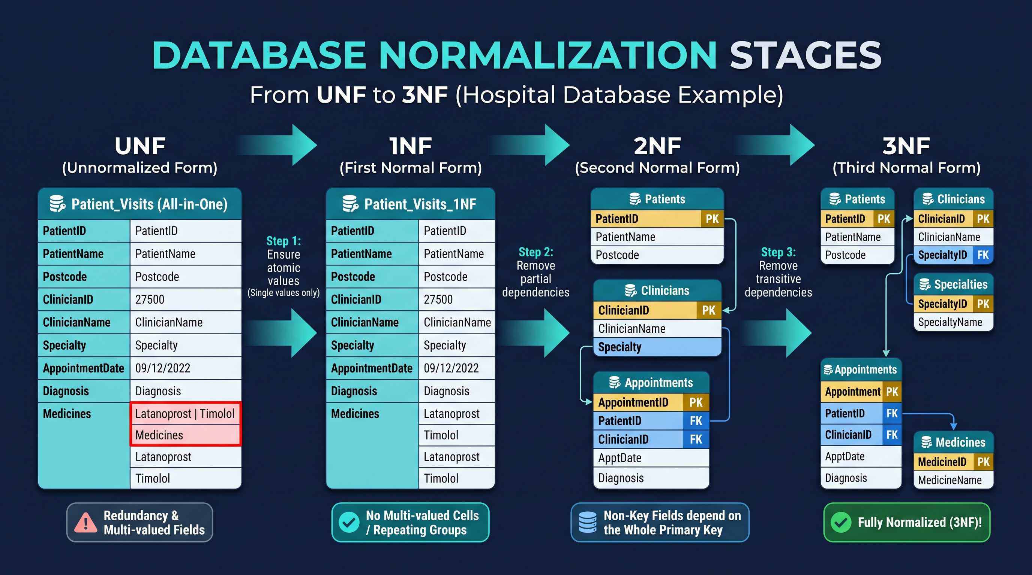

Slide 9
Physical Implementation & Constraints (Part B)
Relational Schema (MySQL): Implemented all 6 core tables (Patient_Table, Clinician_Table, Appointment_Table, Diagnosis_Table, Prescription_Table, and Follow_Up_Plan) using standard SQL data types (VARCHAR, DATE, ENUM).
Referential Integrity: Enforced Primary Keys across all entities and configured Foreign Keys with ON UPDATE CASCADE and ON DELETE RESTRICT to ensure zero orphaned records.
Domain & Business Constraints: Applied NOT NULL to mandatory clinical attributes, UNIQUE on emails and phone numbers to prevent duplicate profiles, and ENUM domains to constrain operational statuses (AppointmentStatus, Priority, Follow_UpStatus).
Data Population & Integrity Verification: Loaded Appendix 1 records alongside 10 synthetic rows per table; validated relational stability through controlled UPDATE and DELETE statements without foreign key conflicts.

Slide 10
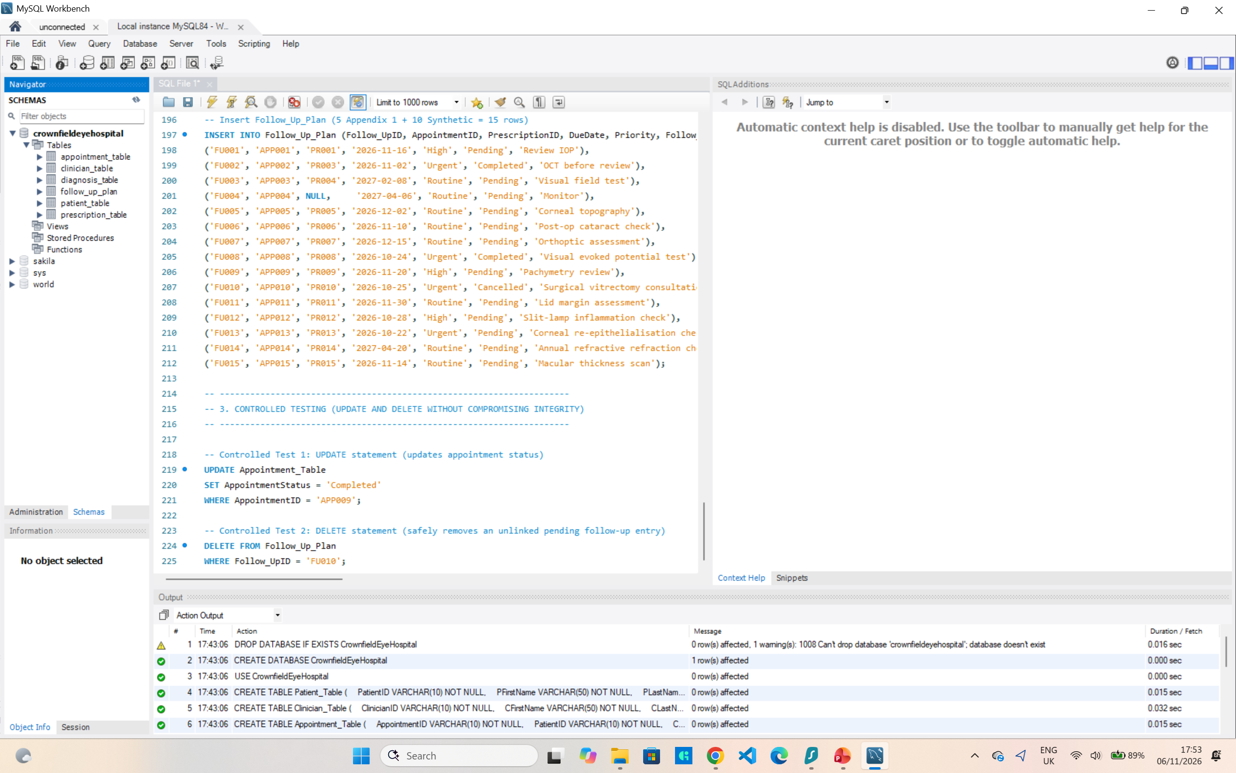

Slide 11
Data Retrieval & Advanced SQL Queries (Part C)
Multi-Table Relational Joins: Executed multi-table INNER and LEFT JOIN operations across Appointment_Table, Patient_Table, Clinician_Table, and Diagnosis_Table to assemble complete patient care journeys without data loss.
Handling Clinical Optionality: Implemented COALESCE alongside LEFT JOIN on Prescription_Table so non-medicated consultations display cleanly as "None Prescribed" rather than returning raw NULL values.
Workload Aggregation: Applied COUNT(DISTINCT ...), GROUP BY, and HAVING filters to analyze appointment distributions and prioritize clinical workloads across hospital locations.
Operational Value: Translates normalized database entities into immediate clinical reporting for hospital administrators, tracking doctor caseloads and urgent follow-up backlogs.

Slide 12
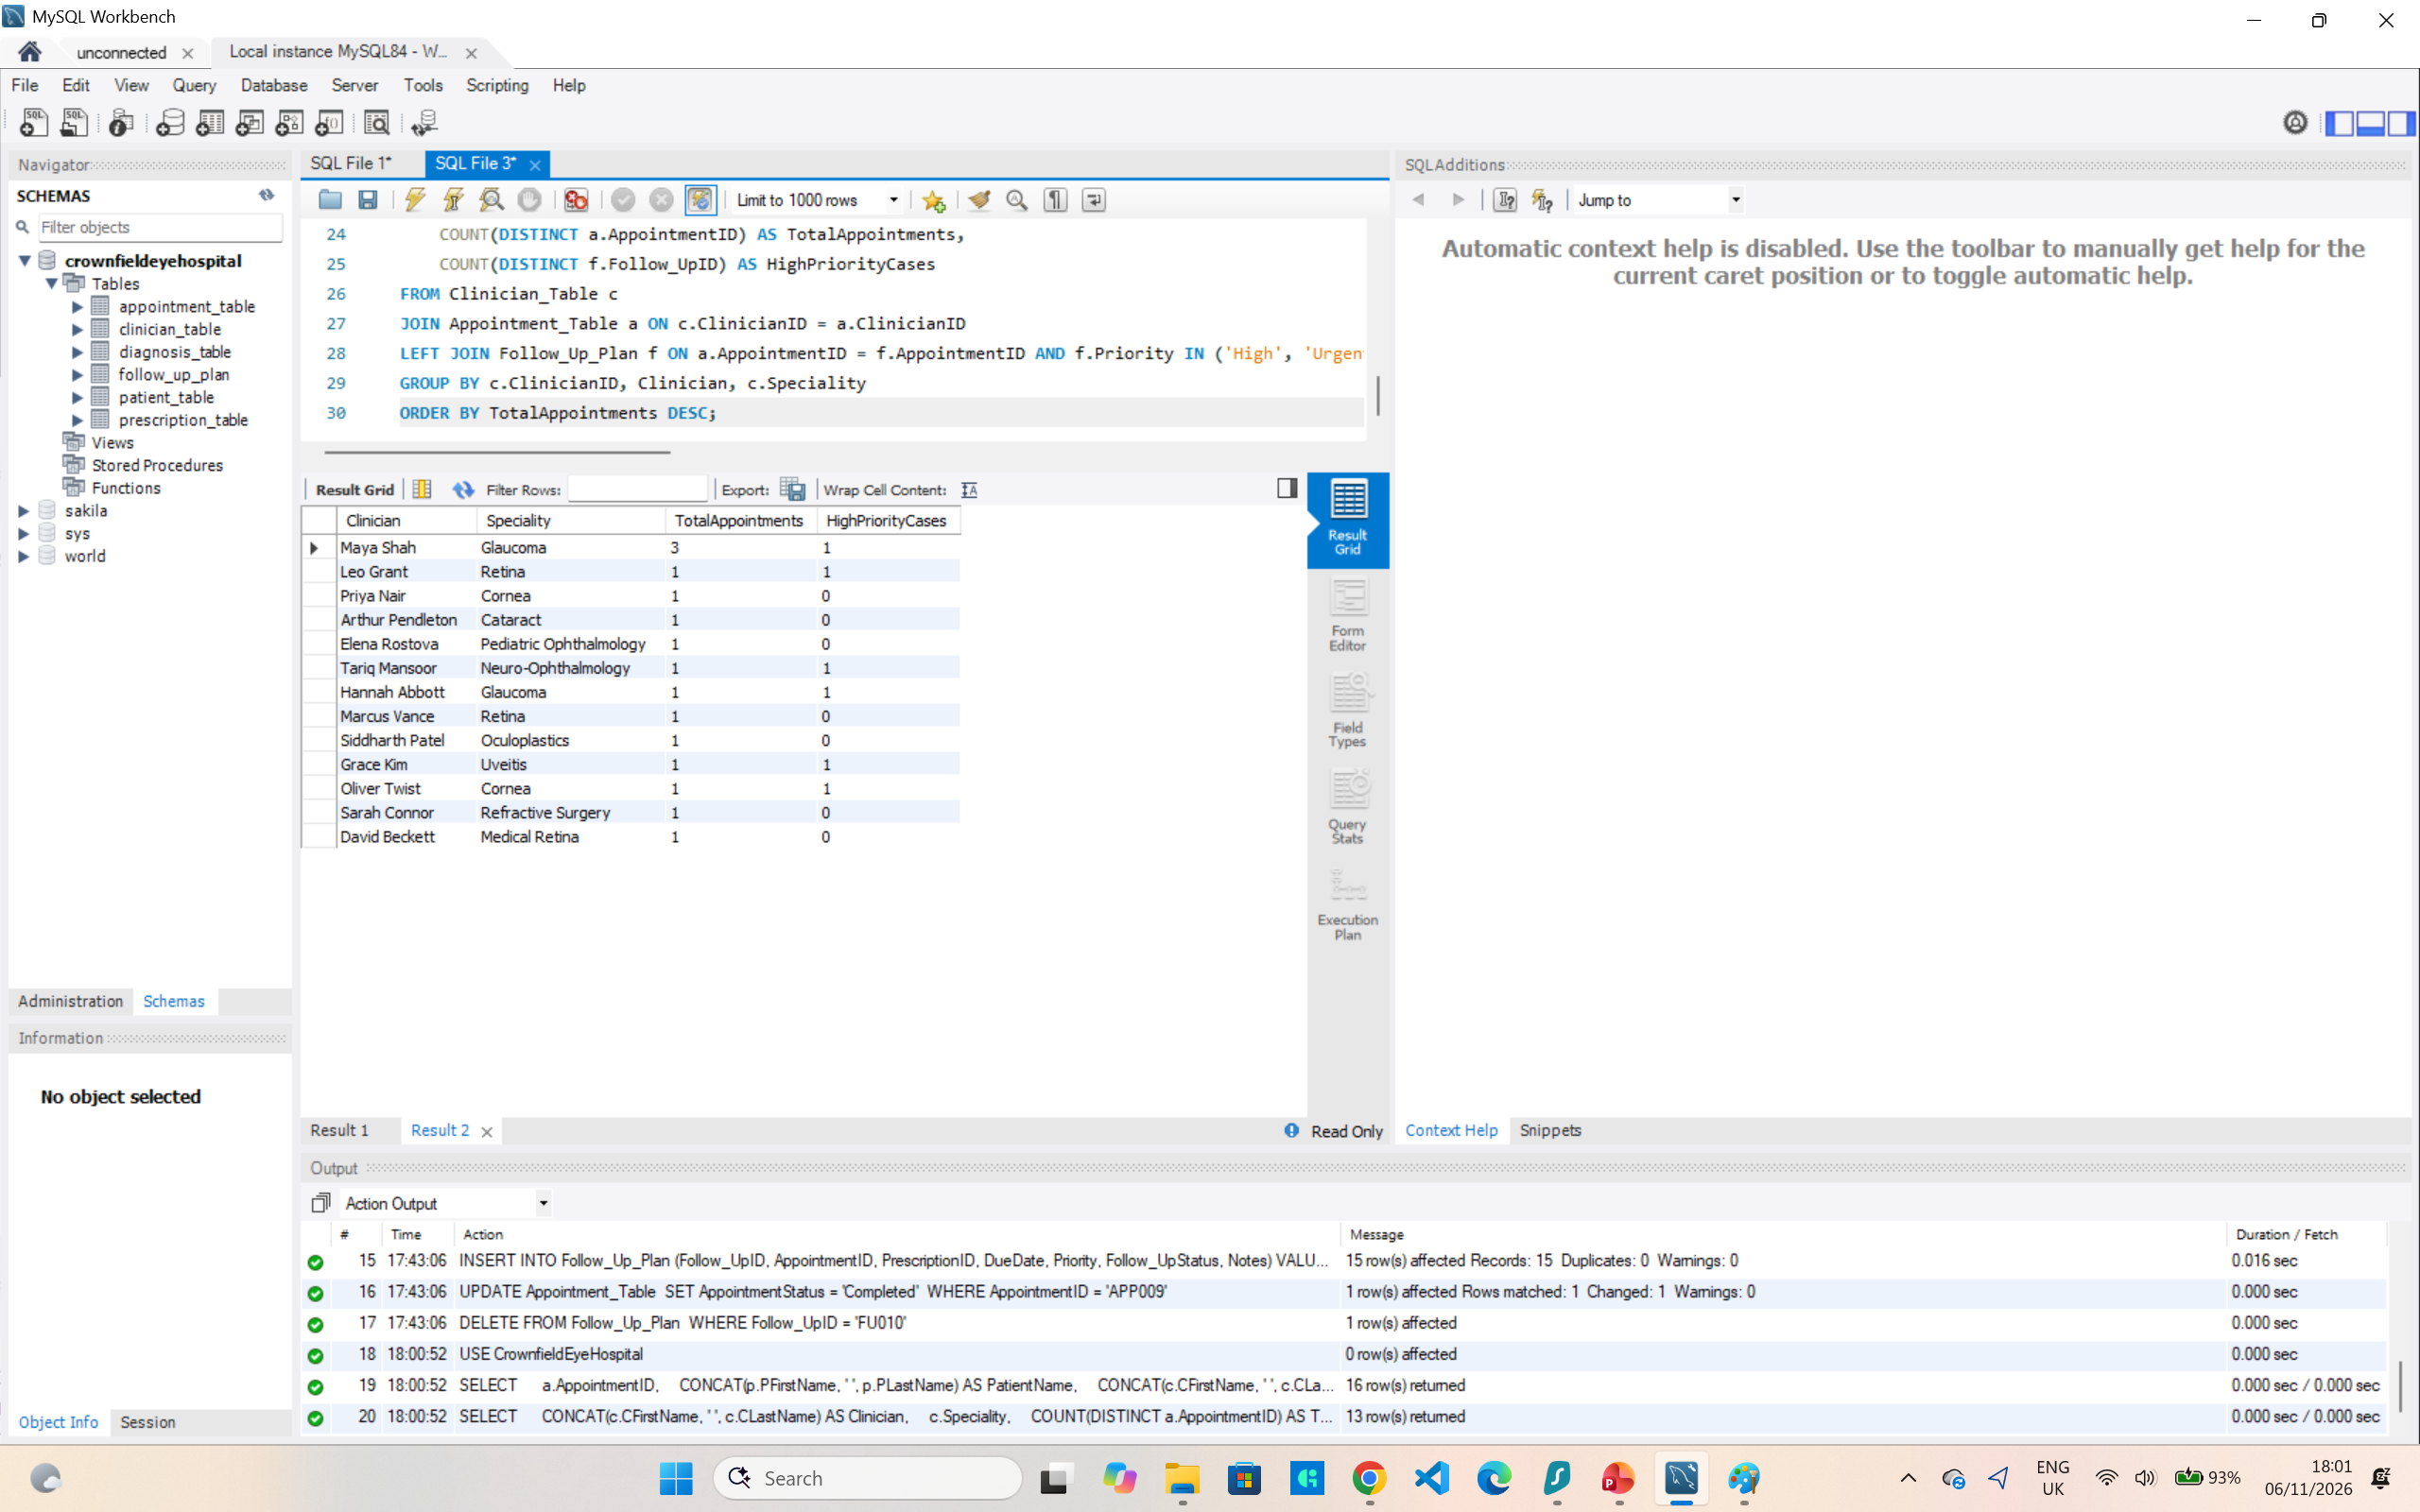

Slide 13
Advanced Automation & Programmability (Part C)
Operational Clinical View (v_UrgentFollowUps): Encapsulated complex four-table joins into a reusable virtual table filtering pending High and Urgent follow-ups, enabling front-desk staff to quickly prioritize care without querying raw transactional tables.
Stored Procedure Automation (sp_GetPatientSummary): Parameterized clinical history retrieval (p_PatientID), isolating complex reporting logic on the database engine, reducing network payload, and preventing SQL injection risks.
Data Abstraction & Security: Enforced separation of concerns by restricting direct table-level access, allowing clinical administrative applications to consume business logic through secure, pre-compiled interfaces.
Performance Benefit: Reduces repeated query parsing and compilation overhead in high-throughput hospital environments while ensuring strict compliance with clinical data retrieval standards.

Slide 14
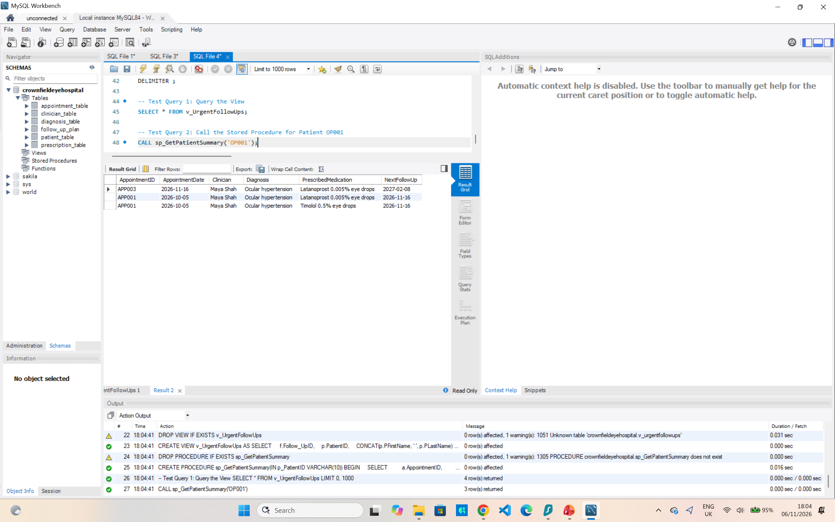

Slide 15
Database Security, Access Control & User Roles (Task B3)
Role-Based Access Control (RBAC): Established dedicated database roles (receptionist_role, clinician_role, admin_role) to replace shared administrative logins and enforce separation of duties.
Principle of Least Privilege (PoLP):
  Front-desk staff have access strictly to Patient_Table and Appointment_Table for booking coordination.
  Medical history, diagnosis codes, and prescriptions remain inaccessible to non-clinical roles.
Regulatory Compliance (GDPR & NHS Caldicott Principles): Protects sensitive patient special category health data by preventing unauthorized clinical exposure and restricting data access on a strict "need-to-know" basis.
Account Security & Verification: Implemented authenticated individual user accounts with default active roles; verified privilege boundaries via SHOW GRANTS audits.

Slide 16
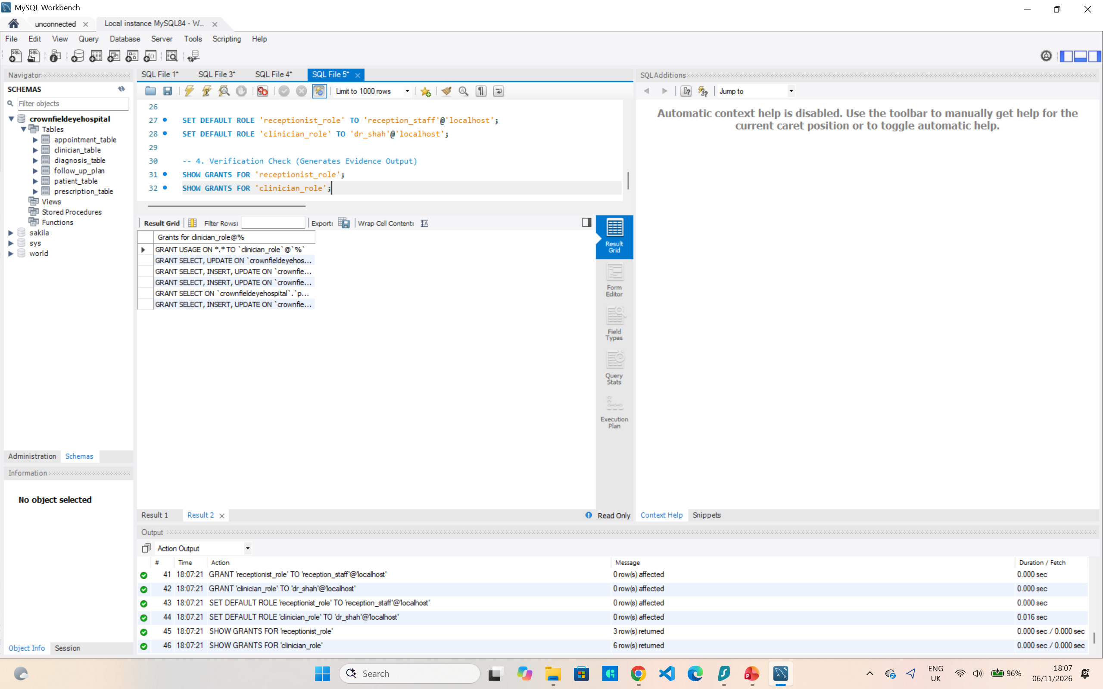

Slide 17
Critical Reflection, System Limitations & Future Enhancements
Architecture Strengths: Successfully decomposed unnormalised hospital spreadsheets into an atomic 3NF relational structure, eliminating update, insertion, and deletion anomalies while maintaining strict referential integrity across clinical care pathways.
Identified Design Limitations:
  Single-clinician appointment model does not natively reflect multidisciplinary surgical teams or dual-observer ophthalmic consultations.
  AppointmentLocation stored as an attribute rather than a distinct clinic/room entity, limiting facility and equipment tracking across trust sites.
  Absence of an automated audit log table to record historical changes to prescriptions and clinical notes for forensic accountability.
Proposed Technical Enhancements:
  Database Triggers & Audit Trail: Implement BEFORE UPDATE/AFTER DELETE triggers on Prescription_Table and Diagnosis_Table to record timestamped change logs in compliance with NHS Caldicott principles and GDPR data modification standards.
  Query Optimization & Indexing: Introduce composite B-Tree indexes on (PatientID, AppointmentDate) and (DueDate, Priority) to accelerate analytical filtering across large clinical histories.
  System Scalability: Decouple clinics into a dedicated Location_Table and establish a many-to-many junction table (Appointment_Staff) to support complex multi-practitioner clinics and room scheduling.

